Slide 1
NHLBI
Deep Learning Crash Course
National Heart, Lung, and Blood Institute
Fall 2021

Slide 2
Outline
Vanilla RNN and backprop through time
Variation of RNNs
LSTM and GRU
Multi-layer RNN and bidirectional RNN

Slide 3

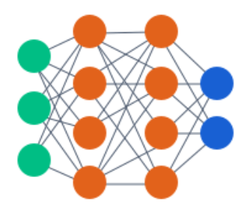
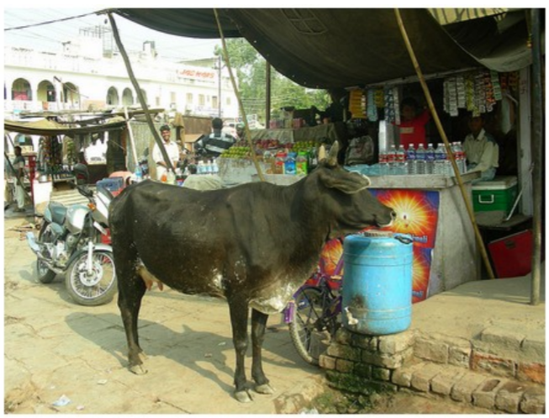
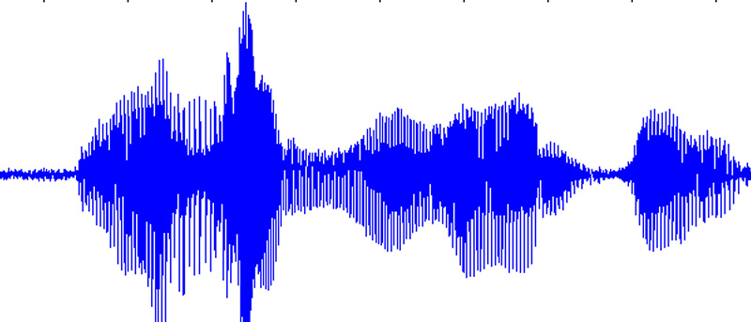

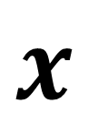
So far, one-to-one mapping
Image Captioning
Sentimental classification
Speech recognition
Machine translation
$$\hat{y}$$
a cow is standing in the middle of a street
Today is nice. Let’s go to the park.
今天天气很好。我们去公园吧。
$$x$$
Image
Video with fixed length
Tabulate feature set
…
Three weeks ago, I bought this product. It worked fine at the beginning but stopped working after a week ..
Today is nice. Let’s go to the park.
https://cs.stanford.edu/people/karpathy/sfmltalk.pdf

Slide 4
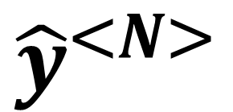
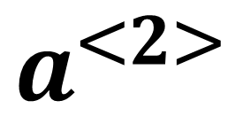
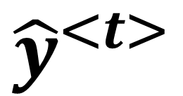
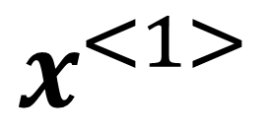
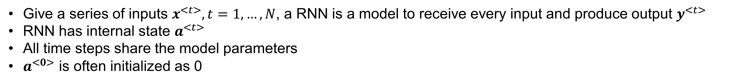
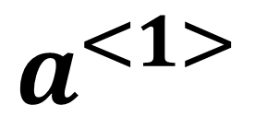
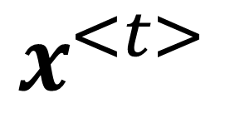
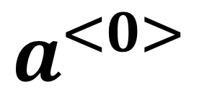
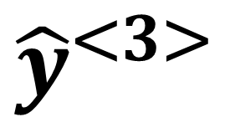
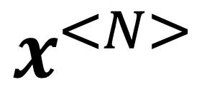
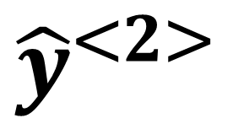
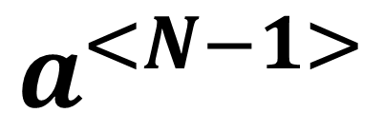
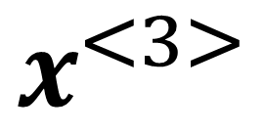
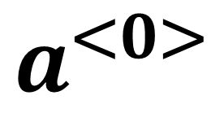
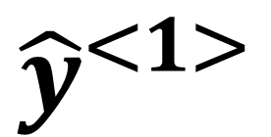
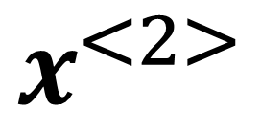
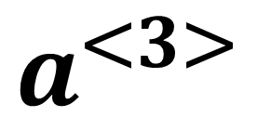
Recurrent Neural Network
Give a series of inputs $x^{<t>}, t=1,…,N$, a RNN is a model to receive every input and produce output $y^{<t>}$
RNN has internal state $a^{<t>}$
All time steps share the model parameters
$a^{<0>}$ is often initialized as 0
$${\hat{y}}^{<1>}$$
$${\hat{y}}^{<2>}$$
$${\hat{y}}^{<3>}$$
$${\hat{y}}^{<N>}$$
$${\hat{y}}^{<t>}$$
$$a^{<1>}$$
$$a^{<2>}$$
$$a^{<3>}$$
… …
$$a^{<N−1>}$$
$$a^{<0>}$$
$$a^{<0>}$$
$$x^{<1>}$$
$$x^{<2>}$$
$$x^{<3>}$$
$$x^{<N>}$$
$$x^{<t>}$$
unrolled along time

Slide 5
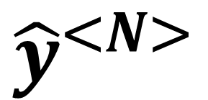
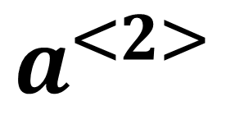
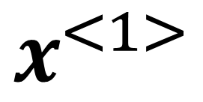
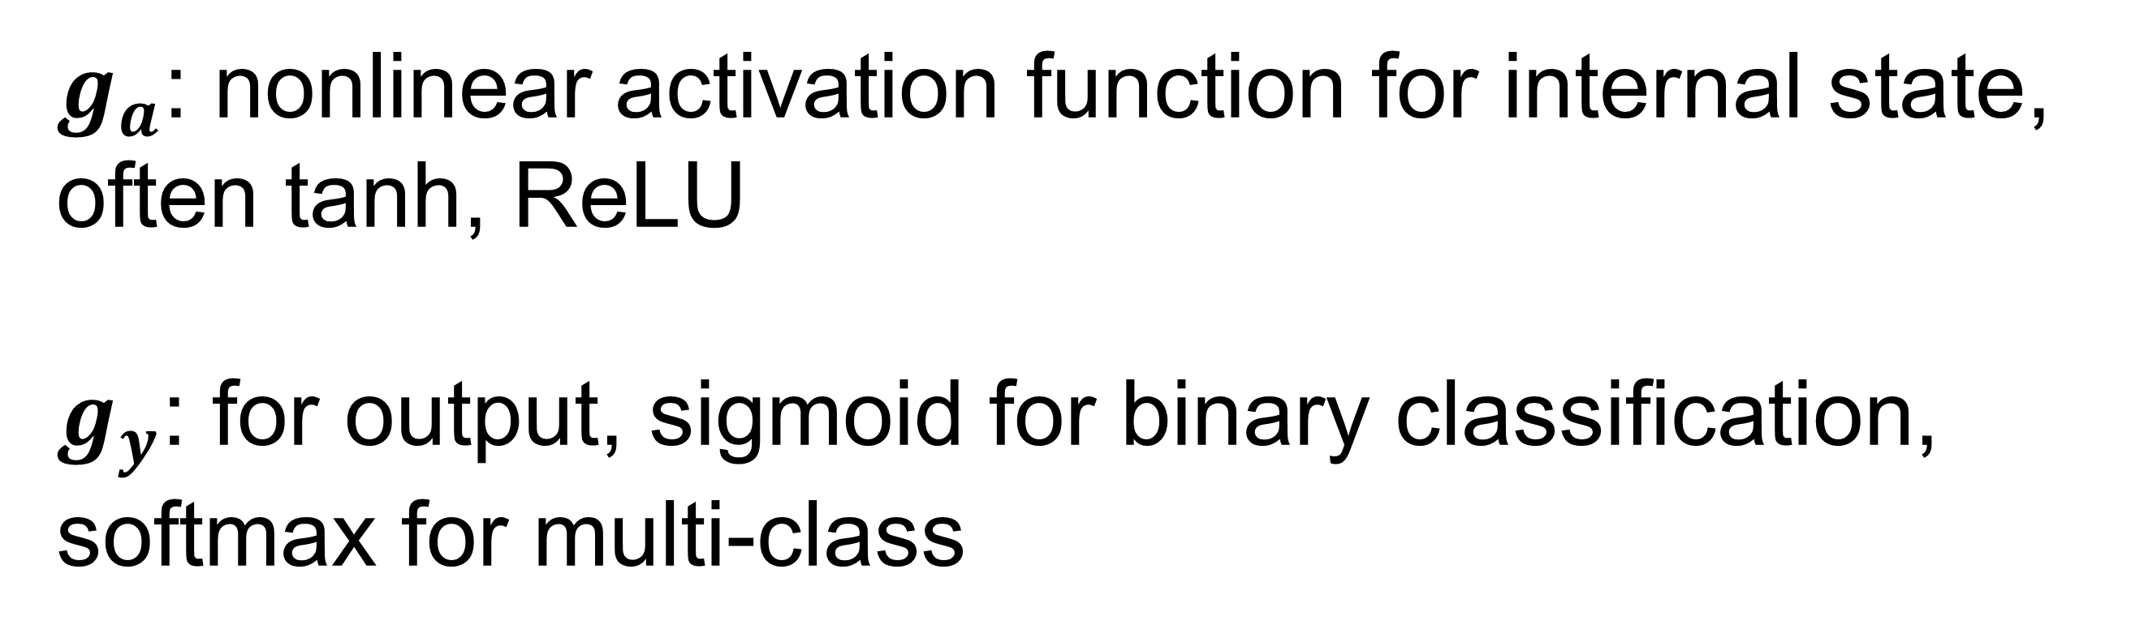
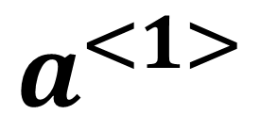
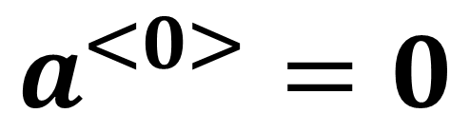
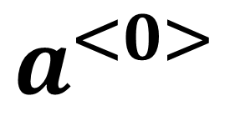
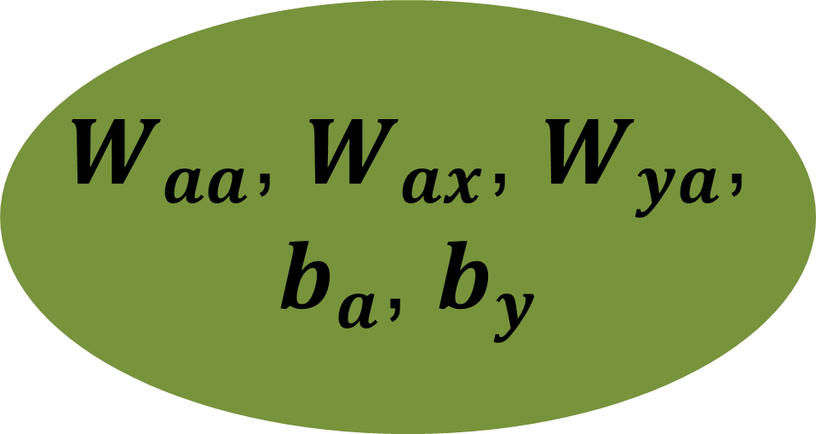
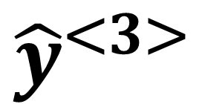
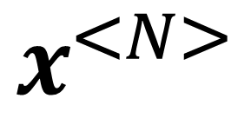
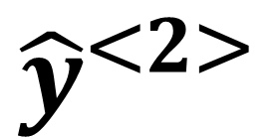
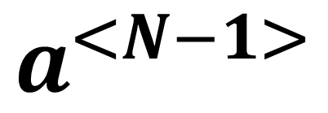
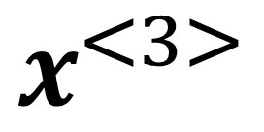
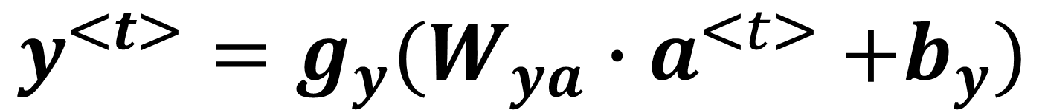
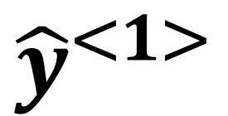
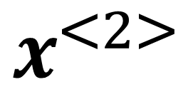
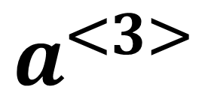
Recurrent Neural Network
input $x^{<t>}, t=1,…,N$, output $y^{<t>}$
internal state $a^{<t>}$
$${\hat{y}}^{<1>}$$
$${\hat{y}}^{<2>}$$
$${\hat{y}}^{<3>}$$
$${\hat{y}}^{<N>}$$
$$a^{<1>}$$
$$a^{<2>}$$
$$a^{<3>}$$
… …
$$a^{<N−1>}$$
$$a^{<0>}=0$$
$$a^{<0>}$$
$$a^{<t>}=g_{a}(W_{aa}{∙a}^{<t−1>}+W_{ax}{∙x}^{<t>}+b_{a})$$
$$y^{<t>}=g_{y}(W_{ya}{∙a}^{<t>}+b_{y})$$
$$x^{<1>}$$
$$x^{<2>}$$
$$x^{<3>}$$
$$x^{<N>}$$
$g_{a}$: nonlinear activation function for internal state,
often tanh, ReLU
$g_{y}$: for output, sigmoid for binary classification,
softmax for multi-class
$W_{aa}$, $W_{ax}$, $W_{ya}$,
$b_{a}$, $b_{y}$
“Elman RNN”
Elman, Jeffrey L. (1990). "Finding Structure in Time". Cognitive Science. 14 (2): 179–211. doi:10.1016/0364-0213(90)90002-E
$${Jordan RNN: a}^{<t>}=g_{a}(W_{aa}{∙a}^{<t−1>}+W_{ax}{∙y}^{<t−1>}+b_{a})$$
Jordan, Michael I. (1997-01-01). "Serial Order: A Parallel Distributed Processing Approach". Neural-Network Models of Cognition - Biobehavioral Foundations. Advances in Psychology. Neural-Network Models of Cognition. 121. pp. 471–495.

Slide 6
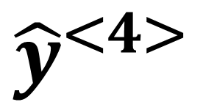
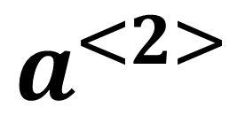
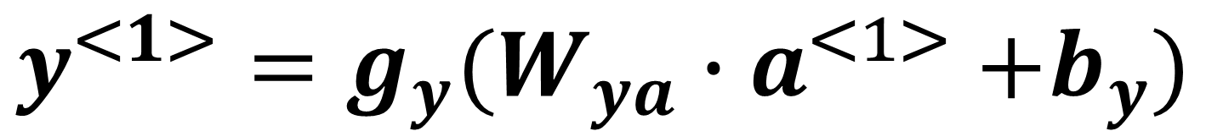
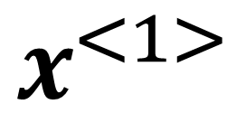
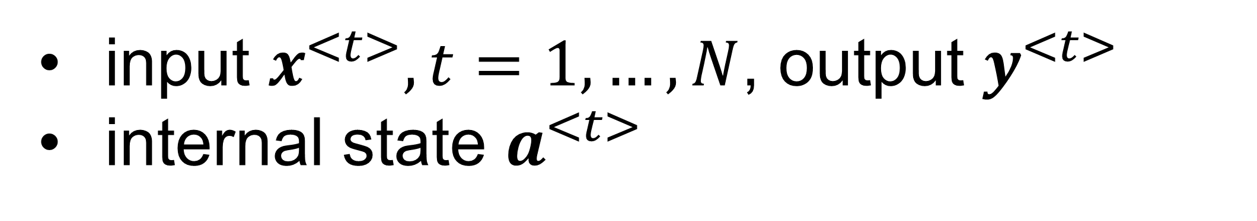
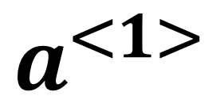
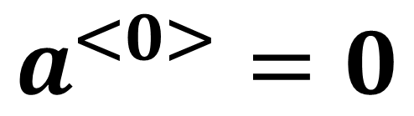
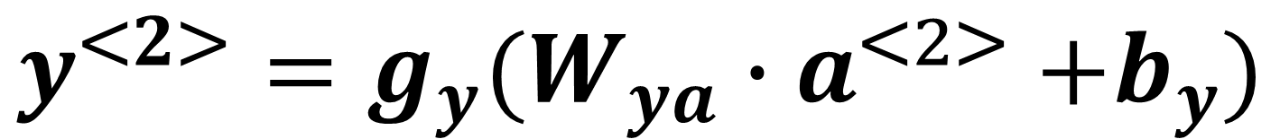
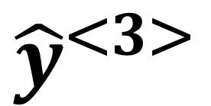
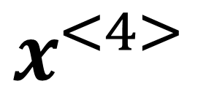
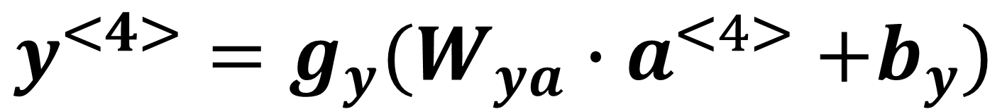
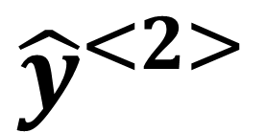






Recurrent Neural Network: Forward pass
input $x^{<t>}, t=1,…,N$, output $y^{<t>}$
internal state $a^{<t>}$
$${\hat{y}}^{<1>}$$
$${\hat{y}}^{<2>}$$
$${\hat{y}}^{<3>}$$
$${\hat{y}}^{<4>}$$
$$a^{<0>}=0$$
$$a^{<1>}=g_{a}(W_{aa}{∙a}^{<0>}+W_{ax}{∙x}^{<1>}+b_{a})$$
$$a^{<1>}$$
$$a^{<2>}$$
$$a^{<3>}$$
$$a^{<0>}$$
$$y^{<1>}=g_{y}(W_{ya}{∙a}^{<1>}+b_{y})$$
$$a^{<2>}=g_{a}(W_{aa}{∙a}^{<1>}+W_{ax}{∙x}^{<2>}+b_{a})$$
$$y^{<2>}=g_{y}(W_{ya}{∙a}^{<2>}+b_{y})$$
$$x^{<1>}$$
$$x^{<2>}$$
$$x^{<3>}$$
$$x^{<4>}$$
$$a^{<3>}=g_{a}(W_{aa}{∙a}^{<2>}+W_{ax}{∙x}^{<3>}+b_{a})$$
$$a^{<4>}=g_{a}(W_{aa}{∙a}^{<3>}+W_{ax}{∙x}^{<4>}+b_{a})$$
$$y^{<3>}=g_{y}(W_{ya}{∙a}^{<3>}+b_{y})$$
$$y^{<4>}=g_{y}(W_{ya}{∙a}^{<4>}+b_{y})$$

Slide 7
















Recurrent Neural Network: recurrent
input $x^{<t>}, t=1,…,N$, output $y^{<t>}$
internal state $a^{<t>}$
$${\hat{y}}^{<1>}$$
$${\hat{y}}^{<2>}$$
$${\hat{y}}^{<3>}$$
$${\hat{y}}^{<4>}$$
$$a^{<0>}=0$$
$$a^{<1>}$$
$$a^{<2>}$$
$$a^{<3>}$$
$$a^{<4>}$$
$$a^{<0>}$$
$$a^{<t>}=g_{a}(W_{aa}{∙a}^{<t−1>}+W_{ax}{∙x}^{<t>}+b_{a})$$
$$x^{<1>}$$
$$x^{<2>}$$
$$x^{<3>}$$
$$x^{<4>}$$
$$a^{<4>}=g_{a}\left(W_{aa}{∙a}^{<3>}+W_{ax}{∙x}^{<4>}+b_{a}\right)$$
$$=g_{a}\left(W_{aa}∙[g_{a}(W_{aa}{∙a}^{<2>}+W_{ax}{∙x}^{<3>}+b_{a})]+W_{ax}{∙x}^{<4>}+b_{a}\right)$$
$$=g_{a}\left(W_{aa}∙[g_{a}(W_{aa}∙[g_{a}(W_{aa}{∙a}^{<1>}+W_{ax}{∙x}^{<2>}+b_{a})]+W_{ax}{∙x}^{<3>}+b_{a})]+W_{ax}{∙x}^{<4>}+b_{a}\right)$$
$$=g_{a}\left(W_{aa}∙[g_{a}(W_{aa}∙[g_{a}(W_{aa}∙[g_{a}(W_{aa}{∙a}^{<0>}+W_{ax}{∙x}^{<1>}+b_{a})]+W_{ax}{∙x}^{<2>}+b_{a})]+W_{ax}{∙x}^{<3>}+b_{a})]+W_{ax}{∙x}^{<4>}+b_{a}\right)$$
$$y^{<4>}=g_{y}(W_{ya}{∙a}^{<4>}+b_{y})$$
Recurrently apply the model parameters to update internal state
$y^{<t>}$ depends on all inputs on or before current time step

Slide 8


















Recurrent Neural Network: loss
input $x^{<t>}, t=1,…,N$, output $y^{<t>}$
internal state $a^{<t>}$
$${\hat{y}}^{<1>}$$
$${\hat{y}}^{<2>}$$
$${\hat{y}}^{<3>}$$
$${\hat{y}}^{<4>}$$
$$a^{<0>}$$
$$a^{<1>}$$
$$a^{<2>}$$
$$a^{<3>}$$
$$a^{<4>}$$
Assume $y^{<t>}$ to take 0 or 1, e.g. like/dislike, binary classification
$$ℓ^{<t>}\left(y^{<t>},{\hat{y}}^{<t>}\right)=−y^{<t>}log({\hat{y}}^{<t>})−\left(1−y^{<t>}\right)log(1−{\hat{y}}^{<t>})$$
$$x^{<1>}$$
$$x^{<2>}$$
$$x^{<3>}$$
$$x^{<4>}$$
$$ℓ=\sum_{t=1}^{N}{ℓ^{<t>}\left(y^{<t>},{\hat{y}}^{<t>}\right)}$$
$$a^{<t>}=g_{a}(W_{aa}{∙a}^{<t−1>}+W_{ax}{∙x}^{<t>}+b_{a})$$
$$y^{<t>}=g_{y}(W_{ya}{∙a}^{<t>}+b_{y})$$
$$\frac{∂ℓ}{∂W_{aa}}=\sum_{t=1}^{N}{\frac{∂ℓ^{<t>}\left(y^{<t>},{\hat{y}}^{<t>}\right)}{W_{aa}}}$$
$$\frac{∂ℓ}{∂W_{ax}}=\sum_{t=1}^{N}{\frac{∂ℓ^{<t>}\left(y^{<t>},{\hat{y}}^{<t>}\right)}{W_{ax}}}$$
$$\frac{∂ℓ}{∂W_{ya}}=\sum_{t=1}^{N}{\frac{∂ℓ^{<t>}\left(y^{<t>},{\hat{y}}^{<t>}\right)}{W_{ya}}}$$
… …

Slide 9

























Recurrent Neural Network: backprop through time
$$ℓ$$
$$\frac{∂ℓ}{∂W_{aa}}=\sum_{t=1}^{N}{\frac{∂ℓ^{<t>}\left(y^{<t>},{\hat{y}}^{<t>}\right)}{W_{aa}}}$$
$$ℓ^{<1>}$$
$$ℓ^{<2>}$$
$$ℓ^{<3>}$$
$$ℓ^{<4>}$$
$$y^{<1>}$$
$$y^{<2>}$$
$$y^{<3>}$$
$$y^{<4>}$$
$$a^{<t>}=g_{a}(W_{aa}{∙a}^{<t−1>}+W_{ax}{∙x}^{<t>}+b_{a})$$
$${\hat{y}}^{<1>}$$
$${\hat{y}}^{<2>}$$
$${\hat{y}}^{<3>}$$
$${\hat{y}}^{<4>}$$
$$y^{<t>}=g_{y}(W_{ya}{∙a}^{<t>}+b_{y})$$
$$a^{<1>}$$
$$a^{<2>}$$
$$a^{<3>}$$
$$a^{<4>}$$
$$a^{<0>}$$
from t=1,2,3,4
from t=2,3,4
from t=3,4
$$x^{<1>}$$
$$x^{<2>}$$
$$x^{<3>}$$
$$x^{<4>}$$
$$W_{aa}$$
from t=4

Slide 10













Recurrent Neural Network: variants
$${\hat{y}}^{<1>}$$
$${\hat{y}}^{<2>}$$
$${\hat{y}}^{<3>}$$
$${\hat{y}}^{<N>}$$
$$a^{<1>}$$
$$a^{<2>}$$
$$a^{<3>}$$
… …
$$a^{<N−1>}$$
$$a^{<0>}$$
Many-to-many, same length
e.g. trigger word detection
$$x^{<1>}$$
$$x^{<2>}$$
$$x^{<3>}$$
$$x^{<N>}$$

Slide 11

Recurrent Neural Network: variants
$$\hat{y}$$
$$a^{<1>}$$
$$a^{<2>}$$
$$a^{<3>}$$
… …
$$a^{<N−1>}$$
$$a^{<0>}$$
Many-to-one, causal
e.g. video grading system
$$x^{<1>}$$
$$x^{<2>}$$
$$x^{<3>}$$
$$x^{<N>}$$

Slide 12

Recurrent Neural Network: variants
Global pooling
$$\hat{y}$$
$${\hat{y}}^{<1>}$$
$${\hat{y}}^{<2>}$$
$${\hat{y}}^{<3>}$$
… …
$${\hat{y}}^{<N>}$$
$$a^{<1>}$$
$$a^{<2>}$$
$$a^{<3>}$$
… …
$$a^{<N−1>}$$
$$a^{<0>}$$
Many-to-one, non-causal
e.g. video grading system
$$x^{<1>}$$
$$x^{<2>}$$
$$x^{<3>}$$
$$x^{<N>}$$

Slide 13
Recurrent Neural Network: variants
$${\hat{y}}^{<1>}$$
$${\hat{y}}^{<2>}$$
$${\hat{y}}^{<3>}$$
… …
$${\hat{y}}^{<N>}$$
$$a^{<1>}$$
$$a^{<2>}$$
$$a^{<3>}$$
… …
$$a^{<N−1>}$$
$$a^{<0>}$$
One-to-many
e.g. music or video generator, with input being a latent variable
$$x^{<1>}$$
Self-regression: Sample from distribution ${\hat{y}}^{<t>}$ and feed it as the next $x^{<t>}$, until <EOS> token is reached np.random.choice(p=prob)

Slide 14










Recurrent Neural Network: variants
$${\hat{y}}^{<1>}$$
$${\hat{y}}^{<2>}$$
$${\hat{y}}^{<3>}$$
… …
$${\hat{y}}^{<N>}$$
$$a^{<1>}$$
$$a^{<2>}$$
$$a^{<3>}$$
… …
$$a^{<N−1>}$$
$$a^{<0>}$$
$$x^{<1>}$$
$${P({\hat{y}}^{<1>},{\hat{y}}^{<2>},{\hat{y}}^{<3>},…,\hat{y}}^{<N>})$$
$$=P\left({\hat{y}}^{<1>}\left|x^{<1>}\right.\right)P\left({\hat{y}}^{<2>}\left|{\hat{y}}^{<1>}\right.\right)P\left({\hat{y}}^{<3>}\left|{\hat{y}}^{<1>},{\hat{y}}^{<2>}\right.\right)…P\left({\hat{y}}^{<N>}\left|{\hat{y}}^{<1>},…,{\hat{y}}^{<N−1>}\right.\right)$$

Slide 15














Recurrent Neural Network: encoder-decoder
$${\hat{y}}^{<1>}$$
$${\hat{y}}^{<2>}$$
$${\hat{y}}^{<3>}$$
… …
$${\hat{y}}^{<M>}$$
encoder
… …
$$a^{<1>}$$
$$a^{<2>}$$
$$a^{<3>}$$
$$a^{<N−1>}$$
$$a^{<0>}$$
…
$$a^{<N>}$$
decoder
$$x^{<1>}$$
$$x^{<2>}$$
$$x^{<3>}$$
$$x^{<N>}$$
Many-to-many, variable length
e.g. machine translation, video captioning

Slide 16

















Recurrent Neural Network: vanishing gradient
$$ℓ$$
$$ℓ^{<N>}$$
$${\hat{y}}^{<1>}$$
$${\hat{y}}^{<2>}$$
$${\hat{y}}^{<N>}$$
$$y^{<N>}$$
$$a^{<1>}=$$
$$g_{a}(W_{aa}{∙a}^{<0>}+W_{ax}{∙x}^{<1>}+b_{a})$$
$$a^{<2>}=$$
$$g_{a}(W_{aa}{∙a}^{<0>}+W_{ax}{∙x}^{<1>}+b_{a})$$
$$a^{<N>}=$$
$$g_{a}(W_{aa}{∙a}^{<N−1>}+W_{ax}{∙x}^{<N>}+b_{a})$$
$$y^{<N>}=g_{y}(W_{ya}{∙a}^{<N>}+b_{y})$$
$$a^{<1>}$$
$$a^{<2>}$$
… …
$$a^{<N−1>}$$
$$a^{<0>}$$
$$x^{<1>}$$
$$x^{<2>}$$
$$x^{<N>}$$
$${\frac{∂ℓ^{<N>}}{∂W_{aa}}|}_{t=1}=\frac{∂ℓ^{<N>}}{∂{\hat{y}}^{<N>}}\frac{∂{\hat{y}}^{<N>}}{∂a^{<N>}}\frac{∂a^{<N>}}{∂a^{<N−1>}}…\frac{∂a^{<2>}}{∂a^{<1>}}\frac{∂a^{<1>}}{∂W_{aa}}$$
$$a^{<N>}=$$
$$g_{a}(W_{aa}{∙a}^{<N−1>}+W_{ax}{∙x}^{<N>}+b_{a})$$

Slide 17



Recurrent Neural Network: vanishing gradient
$${\frac{∂ℓ^{<N>}}{∂W_{aa}}|}_{t=1}=\frac{∂ℓ^{<N>}}{∂{\hat{y}}^{<N>}}\frac{∂{\hat{y}}^{<N>}}{∂a^{<N>}}\frac{∂a^{<N>}}{∂a^{<N−1>}}…\frac{∂a^{<2>}}{∂a^{<1>}}\frac{∂a^{<1>}}{∂W_{aa}}$$
$$a^{<N>}=$$
$$g_{a}(W_{aa}{∙a}^{<N−1>}+W_{ax}{∙x}^{<N>}+b_{a})$$
$$\frac{∂a^{<N>}}{∂a^{<N−1>}}=W_{aa}∙g_{a}^{′} (W_{aa}{∙a}^{<N−1>}+W_{ax}{∙x}^{<N>}+b_{a})$$
$${\frac{∂ℓ^{<N>}}{∂W_{aa}}|}_{t=1}=\frac{∂ℓ^{<N>}}{∂{\hat{y}}^{<N>}}\frac{∂{\hat{y}}^{<N>}}{∂a^{<N>}}\left[\prod_{t=2}^{N}{\frac{∂a^{<t>}}{∂a^{<t−1>}}}\right]\frac{∂a^{<1>}}{∂W_{aa}}$$
$$=\frac{∂ℓ^{<N>}}{∂{\hat{y}}^{<N>}}\frac{∂{\hat{y}}^{<N>}}{∂a^{<N>}}{W_{aa}}^{N−1}\left[\prod_{t=2}^{N}{g_{a}^{′} (W_{aa}{∙a}^{<t−1>}+W_{ax}{∙x}^{<t>}+b_{a})}\right]\frac{∂a^{<1>}}{∂W_{aa}}$$

Slide 18



Recurrent Neural Network: vanishing gradient
$${\frac{∂ℓ^{<N>}}{∂W_{aa}}|}_{t=1}=\frac{∂ℓ^{<N>}}{∂{\hat{y}}^{<N>}}\frac{∂{\hat{y}}^{<N>}}{∂a^{<N>}}{W_{aa}}^{N−1}\left[\prod_{t=2}^{N}{g_{a}^{′} (W_{aa}{∙a}^{<t−1>}+W_{ax}{∙x}^{<t>}+b_{a})}\right]\frac{∂a^{<1>}}{∂W_{aa}}$$
Often cause vanishing gradient
If falling into the linear regime of tanh, then minimal eigen value of $W_{aa}$ comes into the play :
<1, vanishing gradient
>1 exploding gradient

Slide 19


Fix the unstable gradient: skip connections
Add skip-connections
Allow gradient flow to pass back to earlier layers
Network will learn to utilize these skip connections during training
Deep Residual Learning for Image Recognition. 2015. https://arxiv.org/abs/1512.03385
Visualizing the Loss Landscape of Neural Nets. https://arxiv.org/pdf/1712.09913.pdf

Slide 20















Invented much earlier for RNN
1995-1997: Long Short Term Memory cell (LSTM) was proposed.
$${\hat{y}}^{<t>}$$
$${\hat{y}}^{<t>}$$
$$g_{y}$$
$$W_{ya}\left(∗\right)$$
$$+b_{y}$$
$$a^{<t>}=$$
$$g_{a}(W_{aa}{∙a}^{<t−1>}+W_{ax}{∙x}^{<t>}+b_{a})$$
$$y^{<t>}=g_{y}(W_{ya}{∙a}^{<t>}+b_{y})$$
$$a^{<t−1>}$$
$$a^{<t>}$$
$$W_{aa}\left(∗\right)$$
$$+b_{a}$$
$$a^{<t−1>}$$
$$g_{a}$$
$$a^{<t>}$$
$$W_{ax}\left(∗\right)$$
$$x^{<t>}$$
$$x^{<t>}$$
LSTM can Solve Hard Long Time Lag Problems. Advances in Neural Information Processing Systems 9. 1997.

Slide 21

























Vanilla RNN: computing cell
$${\hat{y}}^{<1>}$$
$${\hat{y}}^{<2>}$$
$${\hat{y}}^{<3>}$$
$$g_{y}$$
$$g_{y}$$
$$g_{y}$$
$$W_{ya}\left(∗\right)$$
$$+b_{y}$$
$$W_{ya}\left(∗\right)$$
$$+b_{y}$$
$$W_{ya}\left(∗\right)$$
$$+b_{y}$$
$$W_{aa}\left(∗\right)$$
$$+b_{a}$$
$$W_{aa}\left(∗\right)$$
$$+b_{a}$$
$$W_{aa}\left(∗\right)$$
$$+b_{a}$$
$$a^{<0>}$$
$$g_{a}$$
$$a^{<1>}$$
$$g_{a}$$
$$a^{<2>}$$
$$g_{a}$$
$$W_{ax}\left(∗\right)$$
$$W_{ax}\left(∗\right)$$
$$W_{ax}\left(∗\right)$$
$$x^{<1>}$$
$$x^{<2>}$$
$$x^{<3>}$$

Slide 22


LSTM: introduce a memory cell
$$a^{<t>}=g_{a}(W_{aa}{∙a}^{<t−1>}+W_{ax}{∙x}^{<t>}+b_{a})$$
Vanilla RNN
$$y^{<t>}=g_{y}(W_{ya}{∙a}^{<t>}+b_{y})$$
Introduce a memory cell $c^{<t>}$
1) Compute candidate ${\tilde{c}}^{<t>}$ to update memory cell
$${\tilde{c}}^{<t>}=g_{c}(W_{ca}{∙a}^{<t−1>}+W_{cx}{∙x}^{<t>}+b_{c})$$
2) Add two gets to control whether to update memory cell or keep its previous states
$$c^{<t>}={U∘\tilde{c}}^{<t>}+{F∘c}^{<t−1>}$$
$F=σ(W_{fa}{∙a}^{<t−1>}+W_{fx}{∙x}^{<t>}+b_{f})$: forget gate
$U=σ(W_{ua}{∙a}^{<t−1>}+W_{ux}{∙x}^{<t>}+b_{u})$: update gate

Slide 23






LSTM: introduce a memory cell
LSTM
3) Add one output gate
$$a^{<t>}={O∘c}^{<t>}$$
$${\tilde{c}}^{<t>}=g_{c}(W_{ca}{∙a}^{<t−1>}+W_{cx}{∙x}^{<t>}+b_{c})$$
$O=σ(W_{oa}{∙a}^{<t−1>}+W_{ox}{∙x}^{<t>}+b_{o})$: output gate
$$c^{<t>}={U∘\tilde{c}}^{<t>}+{F∘c}^{<t−1>}$$
4) Compute output
$F=σ(W_{fa}{∙a}^{<t−1>}+W_{fx}{∙x}^{<t>}+b_{f})$: forget gate
$$y^{<t>}=g_{y}(W_{ya}{∙a}^{<t>}+b_{y})$$
$U=σ(W_{ua}{∙a}^{<t−1>}+W_{ux}{∙x}^{<t>}+b_{u})$: update gate
$$a^{<t>}={O∘c}^{<t>}$$
$O=σ(W_{oa}{∙a}^{<t−1>}+W_{ox}{∙x}^{<t>}+b_{o})$: output gate
$$y^{<t>}=g_{y}(W_{ya}{∙a}^{<t>}+b_{y})$$
$F$, $U$, $O$ are vectors, same size as memory cell
${U∘\tilde{c}}^{<t>}$, ${F∘c}^{<t−1>}$, ${O∘c}^{<t>}$: element-wise multiplication

Slide 24













LSTM: computing graph
$${\hat{y}}^{<t>}$$
LSTM
$$g_{y}$$
$$c^{<t>}$$
$${\tilde{c}}^{<t>}=g_{c}(W_{ca}{∙a}^{<t−1>}+W_{cx}{∙x}^{<t>}+b_{c})$$
$$c^{<t−1>}$$
$$c^{<t>}={U∘\tilde{c}}^{<t>}+{F∘c}^{<t−1>}$$
$$F$$
$$W_{ya}\left(∗\right)$$
$$+b_{y}$$
$F=σ(W_{fa}{∙a}^{<t−1>}+W_{fx}{∙x}^{<t>}+b_{f})$: forget gate
$$O$$
$$a^{<t>}$$
$U=σ(W_{ua}{∙a}^{<t−1>}+W_{ux}{∙x}^{<t>}+b_{u})$: update gate
$$a^{<t−1>}$$
stack
$$a^{<t>}={O∘c}^{<t>}$$
$$U$$
$O=σ(W_{oa}{∙a}^{<t−1>}+W_{ox}{∙x}^{<t>}+b_{o})$: output gate
$$y^{<t>}=g_{y}(W_{ya}{∙a}^{<t>}+b_{y})$$
$$\tilde{c}$$
$$x^{<t>}$$
LSTM can Solve Hard Long Time Lag Problems. Advances in Neural Information Processing Systems 9. 1997.

Slide 25

























LSTM: computing graph
$${\hat{y}}^{<t>}$$
$${\hat{y}}^{<t+1>}$$
$$g_{y}$$
$$g_{y}$$
… …
$$c^{<t−1>}$$
$$c^{<t>}$$
$$c^{<t+1>}$$
$$F$$
$$W_{ya}\left(∗\right)$$
$$+b_{y}$$
$$F$$
$$W_{ya}\left(∗\right)$$
$$+b_{y}$$
$$O$$
$$O$$
$$a^{<t+1>}$$
… …
$$a^{<t−1>}$$
$$a^{<t>}$$
stack
stack
$$U$$
$$U$$
$$\tilde{c}$$
$$\tilde{c}$$
$$x^{<t>}$$
$$x^{<t+1>}$$
Gradient can flow back, only passing multiplication or addition, through the memory cell
Avoid ${W_{aa}}^{N−1}$
Avoid $\prod_{t=2}^{N}{g_{a}^{′} (W_{aa}{∙a}^{<t−1>}+W_{ax}{∙x}^{<t>}+b_{a})}$

Slide 26















GRU: Gated Recurrent Unit
$${\hat{y}}^{<t>}$$
GRU
$$g_{y}$$
$${(1−U)∙c}^{<t>}$$
$${\tilde{c}}^{<t>}=g_{c}(W_{ca}{∙R∘a}^{<t−1>}+W_{cx}{∙x}^{<t>}+b_{c})$$
$$1−U$$
$$W_{ya}\left(∗\right)$$
$$+b_{y}$$
$$c^{<t>}={U∘\tilde{c}}^{<t>}+{(1−U)∘c}^{<t−1>}$$
$F=1−U$: forget gate
$$a^{<t−1>}$$
$$a^{<t>}$$
$U=σ(W_{ua}{∙a}^{<t−1>}+W_{ux}{∙x}^{<t>}+b_{u})$: update gate
$${U∙\tilde{c}}^{<t>}$$
$$a^{<t>}=c^{<t>}$$
$$U$$
$O=σ(W_{oa}{∙a}^{<t−1>}+W_{ox}{∙x}^{<t>}+b_{o})$: output gate
$$\tilde{c}$$
$$R$$
$R=σ(W_{ra}{∙a}^{<t−1>}+W_{rx}{∙x}^{<t>}+b_{r})$: relevant gate
$$y^{<t>}=g_{y}(W_{ya}{∙a}^{<t>}+b_{y})$$
$$x^{<t>}$$
Learning phrase representations using RNN encoder-decoder for statistical machine translation. 2014. https://arxiv.org/abs/1406.1078

Slide 27


Other variants
Require large computing resource
Can find better architecture on given tasks
https://lilianweng.github.io/lil-log/2020/08/06/neural-architecture-search.html
Neural Architecture Search with Reinforcement Learning. 2017.

Slide 28


















Bidirectional RNN (BRNN)
$${\hat{y}}^{<1>}$$
$${\hat{y}}^{<2>}$$
$${\hat{y}}^{<3>}$$
$${\hat{y}}^{<N>}$$
Some applications provide the entire series, e.g. machine translation
Or, the deployment does not require real-time processing
Allow utilize information from the past and the future
$${\overset{⃑}{a}}^{<1>}$$
$${\overset{⃑}{a}}^{<2>}$$
$${\overset{⃑}{a}}^{<3>}$$
… …
$${\overset{⃑}{a}}^{<N>}$$
$${\overset{⃑}{a}}^{<0>}$$
… …
$${\overset{⃐}{a}}^{<N+1>}$$
$${\overset{⃐}{a}}^{<1>}$$
$${\overset{⃐}{a}}^{<2>}$$
$${\overset{⃐}{a}}^{<3>}$$
$${\overset{⃐}{a}}^{<N>}$$
$$x^{<1>}$$
$$x^{<2>}$$
$$x^{<3>}$$
$$x^{<N>}$$
$$y^{<t>}=g_{y}(W_{ya}{∙[\overset{⃑}{a}}^{<t>};{\overset{⃐}{a}}^{<t>}]+b_{y})$$
or
$$y^{<t>}=g_{y}(W_{ya}{∙(\overset{⃑}{a}}^{<t>}+{\overset{⃐}{a}}^{<t>})+b_{y})$$

Slide 29











Bidirectional RNN (BRNN)
Still acyclic graph
Can run forward-pass and backprop
Supported by PyTorch or Keras
$${\overset{⃐}{a}}^{<1>}$$
$${\overset{⃑}{a}}^{<1>}$$
$${\overset{⃑}{a}}^{<2>}$$
$${\overset{⃐}{a}}^{<2>}$$
$$x^{<1>}$$
$${\overset{⃑}{a}}^{<3>}$$
$${\overset{⃐}{a}}^{<3>}$$
$$x^{<4>}$$
$${\overset{⃑}{a}}^{<4>}$$
$${\overset{⃐}{a}}^{<4>}$$
Two independent RNN put together
Equivalent to run two RNNs; one is fed with t=1,…,N and another is fed with t=N,N-1, …, 1

Slide 30

































Multi-layer RNN or deep RNN
$${\hat{y}}^{<1>}$$
$${\hat{y}}^{<2>}$$
$${\hat{y}}^{<3>}$$
… …
$${\hat{y}}^{<N>}$$
$$a^{[l]<t>}=g_{a}(W_{aa}^{[l]}{∙a}^{[l]<t−1>}+W_{ax}^{[l]}{∙\hat{y}}^{[l−1]<t>}+b_{a}^{[l]})$$
$$a^{[3]<1>}$$
$$a^{[3]<2>}$$
$$a^{[3]<3>}$$
… …
$$a^{[3]<N−1>}$$
$$a^{[3]<0>}$$
$$y^{[l]<t>}=g_{y}(W_{ya}^{[l]}{∙a}^{[l]<t>}+b_{y}^{[l]})$$
$${\hat{y}}^{[2]<1>}$$
$${\hat{y}}^{[2]<2>}$$
$${\hat{y}}^{[2]<3>}$$
$${\hat{y}}^{[2]<N>}$$
$$a^{[2]<1>}$$
$$a^{[2]<2>}$$
$$a^{[2]<3>}$$
… …
$$a^{[2]<N−1>}$$
$$a^{[2]<0>}$$
$${\hat{y}}^{[1]<1>}$$
$${\hat{y}}^{[1]<2>}$$
$${\hat{y}}^{[1]<3>}$$
$${\hat{y}}^{[1]<N>}$$
$$a^{[1]<1>}$$
$$a^{[1]<2>}$$
$$a^{[1]<3>}$$
… …
$$a^{[1]<N−1>}$$
$$a^{[1]<0>}$$
$$x^{<1>}$$
$$x^{<2>}$$
$$x^{<3>}$$
$$x^{<N>}$$

Slide 31
Multi-layer RNN or deep RNN
$${\hat{y}}^{<1>}$$
$${\hat{y}}^{<2>}$$
$${\hat{y}}^{<3>}$$
… …
$${\hat{y}}^{<N>}$$
… …
… …
… …
… …
… …
… …
$$x^{<1>}$$
$$x^{<2>}$$
$$x^{<3>}$$
$$x^{<N>}$$

